Slide 1
IACC Strategic Planning
Workgroup Meeting
April 21,2008

Slide 2
Structure for Strategic Plan
IACC
Treatment Workshop
Diagnosis Workshop
Risk Factors Workshop
Biology Workshop
SP Work Group
IACC
Strategic Planning
(SP) Workgroup
Scientific Workshops
All involve
  Stakeholders
  NIMH Autism Team

Slide 3
Completed Steps
Strategic Planning Process Approved by
IACC-Nov - 07
Stakeholders RFI- Dec 07 - Jan 08
Four Scientific Workshops Held – Jan 08
SP Workshop Meeting – Feb 08
New SP Workgroup Formed by AICC – March 08

Slide 4
SP WG Roster
Steve E. Hyman, M.D. (chair) Harvard University
David Amaral, Ph.D. University of California, Davis
Peter Bell MBA Autism Speaks
Mark F. Blaxill MBA Coalition for Safe Minds
Judith Cooper, Ph.D. NIDCD
Geraldine Dawson, Ph.D. Autism Speaks
Steve Eiken, M.A. Thomson Healthcare
Daniel Geschwind, M.D., Ph.D. UCLA
Martha Herbert, M.D., Ph.D. Harvard Medical School
Alice Kau, Ph.D. NICHD
Catherine Lord, Ph.D. University of Michigan
David Mandell, Sc.D. University of Pennsylvania
Prisca Chen Marvin, J.D.
Sam Odom, Ph.D. University of North Carolina
Isaac Pessah, Ph.D. University of California, Davis
Denise D. Resnisk SARRC
Stephen Shore, Ed.D IACC Public Member
V. Fan Tait, M.D. American Academy of Pediatrics
Edwin Trevathan, M.D., MPH CDC
Lucille Zeph, Ed. D. University of Maine
Andrew Zimmerman, M.D. Kennedy Krieger Institute

Slide 5
Public Participation
Public registrants could listen to the meeting via teleconference link and view slides on the Internet
198 registered
121 participated
Average length of call = 229 minutes
Two workgroup members and some IACC members participated virtually and had the capability to speak and be heard

Slide 6
Values
Sense of Urgency – We will focus on what steps we can take now to be responsive to the needs of individuals and families affected by ASD.
Spirit of Collaboration – We will treat others with respect, listen to diverse views with open minds, and foster discussions where participants can comfortable offer opposing opinions.
Consumer – focused – We will focus on making a difference in the lives of people affected by ASD, including individuals with ASD, their families, medical practitioners, educators, and scientists.

Slide 7
Values
Excellence – We will pursue basic and clinical research of the highest quality to protect the safety and advance the best interest of those affected by ASD.
Partnership in Action- We will value cross-disciplinary approaches, data sharing, teamwork, and partnerships with clearly defined roles and responsibility.
Accountability – We will develop SMART (specific, measurable, achievable, realistic, and time-bound) research objectives aligned with funding priorities and develop systems for evaluations and course corrections.

Slide 8
Framework for Initiatives
WHEN should I be concerned about my child’s development? (7)
HOW can I understand what is happening to my child? (9)
WHAT caused this to happen and can this be prevented? (7)
WHICH treatments will help my child? (9)
WHERE can I turn for services? (4)
WHAT does the future hold? (5)

Slide 9
Goals for Workgroup
Review the 2007 ASD research funding portfolio
Prioritize research initiatives within the six question framework
Discuss budgetary requirements of the strategic plan

Slide 10
NIH FY 2007 Autism Portfolio
$127 million on autism grants, contracts, intramural research projects.
Additional $3.9 million invested in National Database for Autism Research (NDAR) in FY07.
NIH Autism Coordinating Committee (ACC) categorized diverse portfolio of research activities into five broad research areas with subcategories.
Assigned each research activity and associated funding to one research area and subcategory based on this primary aims and objectives.

Slide 11
Research Areas and Corresponding Subcategories
Biology
  Subcategories: Clinical Neuroscience, Basic Neuroscience, and Biological Systems
Treatment
  Subcategories: Psychopharmacology, Biomedical, Behavioral/Psychosocial, Services Research, and Biomarkers for Treatment Response
Diagnosis
  Subcategories: Instrument Development, Early Identification, Characterization, Incidence/Prevalence
Risk Factors
  Subcategories: Genetics/Genomics, Environmental Influences and Gene x Environment Interplay, Mechanisms and Model Systems of Environmental Influences, and Psychosocial
Other
  Subcategories: Research Resources (e.g., data systems, repositories of biomaterials), Education and Dissemination, and Other

Slide 12
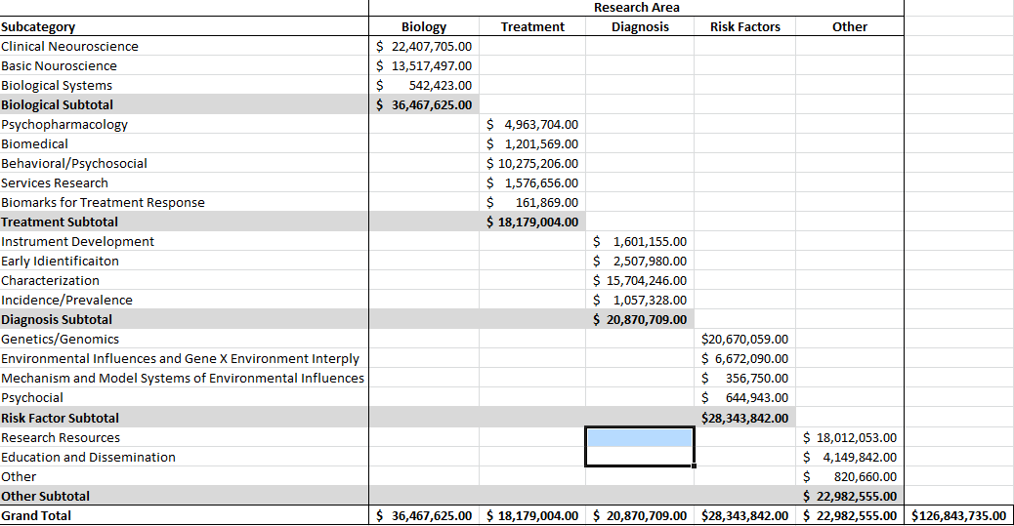
FY 2007 NIH Autism Portfolio
Total Autism Funding by Research Area and Subcategory

Slide 13
FY 2007 NIH Autism Portfolio
Percentage of Total Autism Funding ($126,843,735) by Research Area

Slide 14
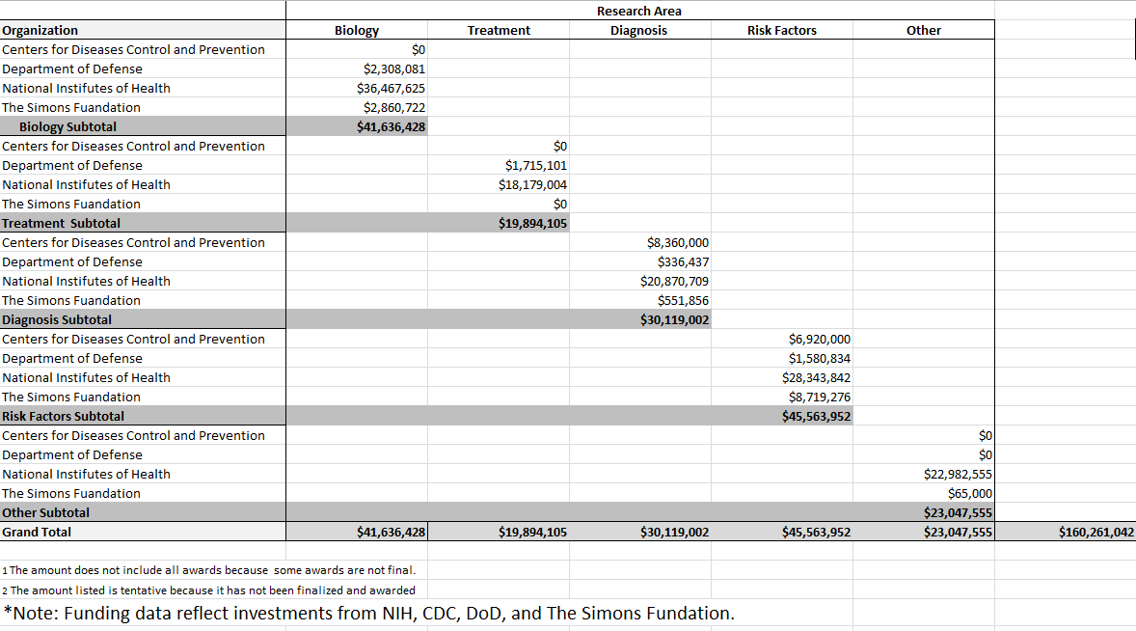
FY 2007 NIH Autism Portfolio
Total Autism Funding* by organization and Research Area

Slide 15
FY 2007 Autism Portfolio
Percentage of Total Autism Funding* ($160, 261,042) by Research Area
*Note: Funding data reflect investments from NIH, CDC, DoD, and The Simons Foundation.

Slide 16
Prioritization of Initiatives
Discussed and developed criteria for prioritization
Prioritized within the six question domains to ensure coverage in each area
Each workgroup member selected highest priority initiates and distributed 100 points amongst choices

Slide 17
Prioritization of Initiatives
4. Results of workgroup scoring were tallied
5. Results of prioritization reviewed
6. Prioritized initiatives forwarded to IACC

Slide 18
SP WG Comments
Emphasize to AICC that this is a “work-in – progress”
Would like to have a vision, mission and aspirational goals to provide overall structure for WG deliberations
Took a middle-ground position that more work needs to be done but doing initial prioritization will move things forward

Slide 19
I. WHEN SHOULD I BE CONCERNED ABOUT MY CHILD’S DEVELOPMENT?
515 (12) I.C.2. Identify Relevant Phenotypes that Relate to Etiology, Symptom Presentation, and Outcome
360 (10) I.A.2. Collaborative Development of Streamlined Screening/Diagnostic Approaches
359 (12) I.A.3. Screening and Diagnostic Instruments in Underrepresented Populations
276 (11) I.C.1. The Development of Improved Categorical and Dimensional Measures of ASD
234 (9) 1.8.2. Characterizing and Improving the Diagnostic Process in the Community
234 (8) I.A.1. Predictive Validity of Existing Screens in Community Setting
120 (3) 1.8.1. Evaluating Diagnostic Criteria/Approaches

Slide 20
II. HOW CAN I UNDERSTAND WHAT IS HAPPENING TO MY CHILD?
381 (10) II.A.3. Role of Immune and Infectious Factors in the Pathogenesis of Autism - Human and Animal Studies
333 (12) II.A.4. Postmortem Brain and Tissue Acquisition Initiative
297 (11) II.B.2. Developing Biomarkers for Autism
296 (9) II.A.1. Multidisciplinary Longitudinal Study of Infants with Autism Before Age Three
263 (9) II.A.2. Understanding Mechanisms of Neuroplasticity in Autism
220 (7) II.B.1. Gender Differences in the Biological Features of Autism
145 (5) II.B.3. Gene-based Phenotyping and Cognitive Neuroscience
108 (3) II.A.5. Identification of Large-Scale Neural Systems Whose Function is Altered in Pre-adolescent Autism
45 (2) II.B.4. New Paradigm for Clinical Genetic Evaluation and Subsequent Diagnosis

Slide 21
III. WHAT CAUSED THIS TO HAPPEN AND HOW THIS BE PREVENTED?
652 (17) III.B.3. Analysis of Mechanisms Underlying the Interplay of Genetic and Environmental Factors
373 (11) III.B.5. Develop Resources for Appropriate Control and Comparison Groups for Biological, Genetic and Other Studies of ASD 364 (14) III.B.2. Studies of Risk Factor Exposures From Pre-Conception to Early Postnatal Life
230 (8) III.B.4. Methods Development for Biologic Exposures I Biomarkers 208 (5) III.A.1. Large-scale Resource of Genomic Data on Autism Spectrum Disorders
148 (5) III.B.1. Risk Factor Studies in Other Special
124 (5) II.A.2. Informing the Genetics and Neurobiology of ASD Based on New Heritable Phenotypes Populations

Slide 22
IV. WHICH TREATMENTS WILL HELP MY CHILD?
455 (13) IV.A.1. Interventions for Older Children and Adults with ASD
313 (9) IV.B.2. Investigation of Efficacy and Safety of Commonly Used and Untested Treatments for ASD
285 (9) IV.A.2. Intervention and Prevention Approaches for Infants and Toddlers at Risk for Autism
252 (7) IV.B.4. Fast Track Mechanisms to Facilitate Translational Treatment Research 211 (6) IV.B.3. Animal Models and Cellular Systems for Developing Treatments for Autism
195 (9) IV.B.1. Role of Co-morbidity in ASD Treatment
140 (6) IV.A.3. Efficacy Trials for Comprehensive Intervention Models for Individual with ASD Across Ages
98 (4) IV.C.2. Novel Treatments of Core Symptoms
48 (2) IV.C.1. Identification of Biomarkers to Guide Treatment Selection and Evaluation of Treatment Outcome

Slide 23
V. WHERE CAN I TURN FOR SERVICES?
623 (15) V.A.2. Identify and Evaluate Models of Effective Dissemination of Evidence-Based Practices (EBP) into Community Programs
568 (13) V.A.3. Evaluation of Community-Based Intervention Models Informed by MultiDisciplinary Best Practices
454 (11) V.A.4. Cost-Outcome Studies of Intervention Models for People with Autism Spectrum Disorder (ASD)
445 (1 0) V.A.1. State of the States for Individuals with Autism Spectrum Disorder (ASD)

Slide 24
VI. WHAT DOES THE FUTURE HOLD?
487 (12) VI.A.2. Improved Identification and Characterization of Autism in Adulthood
453 (13) VI.C.2. Develop Resources to Coordinate Large PopulationBased ASD Initiatives (NDAR, CDC, NIH), IAN, State Registries)
436 (9) VI.A.1. Understanding Developmental Trajectories of Children and Families Affected by ASD
433 (9) VI.B.1. Enhance Tracking of ASD Prevalence in Children and Adolescents
291 (7) VI.C.1. Merging and Analyzing Administrative Databases Relevant to Diagnosis, Course, Interventions, and Long-Term Outcomes

Slide 25
Comments on Results
Some individual initiatives scored noticeably higher than the others in the same question domain
Overlap areas are instructive in that the highlight areas of general interest, e.g. biomarkers – consolidation of initiatives can now be done
Different opinions about scoring within question bins versus across question bins

Slide 26
Budgetary Requirements
Treatment funding % was relatively smaller – but other areas inform treatment such as diagnosis (early ID), or biological studies of mechanisms
“Don’t starve one area to feed another”
Could reapportion within a funding domain, e.g. risk factors – increase environment, decrease genetics

Slide 27
Budgetary Requirements
Need more clinical trial infrastructure – share with other development disorders?
  Efforts by Autism Speaks CTN and ATN noted
Need for fast track mechanisms for high risk, high yield or n of 1 studies
Some studies are more expensive to do than others so just looking at % can be misleading
% in areas not as important as putting funds towards highest priorities

Slide 28
Usefulness of SP
Identify priorities so that partnership between private and government groups will facilitate achieving the goals
Develop RFAs or special emphasis panels
Enable ASD initiatives to be funded that may be out of priority score order
Attract excellent researchers to ASD research – SP makes a strong case for building opportunities and stimulating quality research

Slide 29
Today’s IACC Discussion
IACC to review draft vision, mission and aspirational goal for strategic plan
Review and discuss a draft template for strategic plan
Approve further development of a SWOT (Strengths, Weaknesses, Opportunities, Threats) analysis of the comprehensive funding portfolio and 41 research initiatives

Slide 30
Next Steps
Review input from Town Hall Meeting
Develop short and long term objectives with measurable outcomes
Refine prioritization and consolidate research initiatives
Consider infrastructure/mechanism needs

Slide 31
Strategic Planning Process
Process Phase
Approximate Timing
B. Development of Draft SP Process
C. IACC Meeting: Discussion & Adoption of SP Process
D. SP Workgroup: Organize Workshops & Charge
E. RFI: Stakeholder Input on ASD Research Priorities
F. Four Scientific Workshops to Generate Research Priorities
August
2007
September
October
November
December
January
2008
l.
Development of Strategic Priorities

Slide 32
Strategic Planning Process
Process Phase
Approximate Timing
G. SP Workgroup: Preliminary Ranking of Overall Priorities
H. Stakeholder Feedback on Ranked Priorities
I. IACC Meeting: Final Priority-Setting & Discussion of Budgetary Requirements for SP
J. Begin Writing Strategic Plan
February
2008
March
April
ll.
Plan Development and Consolidation

Slide 33
Strategic Planning Process
Process Phase
Approximate Timing
K. SP Workgroup: Consider Implementation Plans for Top Research Priorities
L. First Draft of Strategic Plan
M. IACC Meeting: Discussion/Approval of Draft Strategic Plan
N. Formation of SP Implementation Workgroup
O. Strategic Plan Completed and Sent to DHHS
H. Stakeholder Feedback on Final Plan
April
May
June
lll.
Final Document
Approval

